Slide 1
Manhole health monitoring system
Team name - Igniters
Team members - Karan Rathore , Pooja Kanojia
Track - Open Innovation challenge

Slide 2
Domain - Road Safety

Slide 3
Problem statement - To design and implement an IoT system that monitors the health of sewage lines and provides real-time status of the same

Slide 4
Stakeholders - Municipalities, Pedestrians, Animals (cows, dogs), Travellers

Slide 5
Objectives -
Monitor real-time status of manholes
To provide user alerts and real-time manhole status
Predict overflow of manholes to help in disaster management
Real-time manhole locations with open lids

Slide 6
Proposed solution -
An Iot solution which will contain various sensors like -
DHT11 temperature sensor, Ultrasonic sensor, HX711 Load cell and MQ-4 Gas sensor. These sensors will be placed with the manholes which will monitor the health of these manholes thereby helping in disaster management and loss of life

Slide 7
Project flow -
Sensor data Gateway Cloud server

Slide 8
Implementation
Technology stack -
Hardware - raspberry pi
Language - Python programming language
Cloud platform - Thingspeak
Web dashboard - Bootstrap, HTML, CSS
Tools - IFTTT - email alerts, Twilio - SMS alerts
Editor - Visual studio code

Slide 9
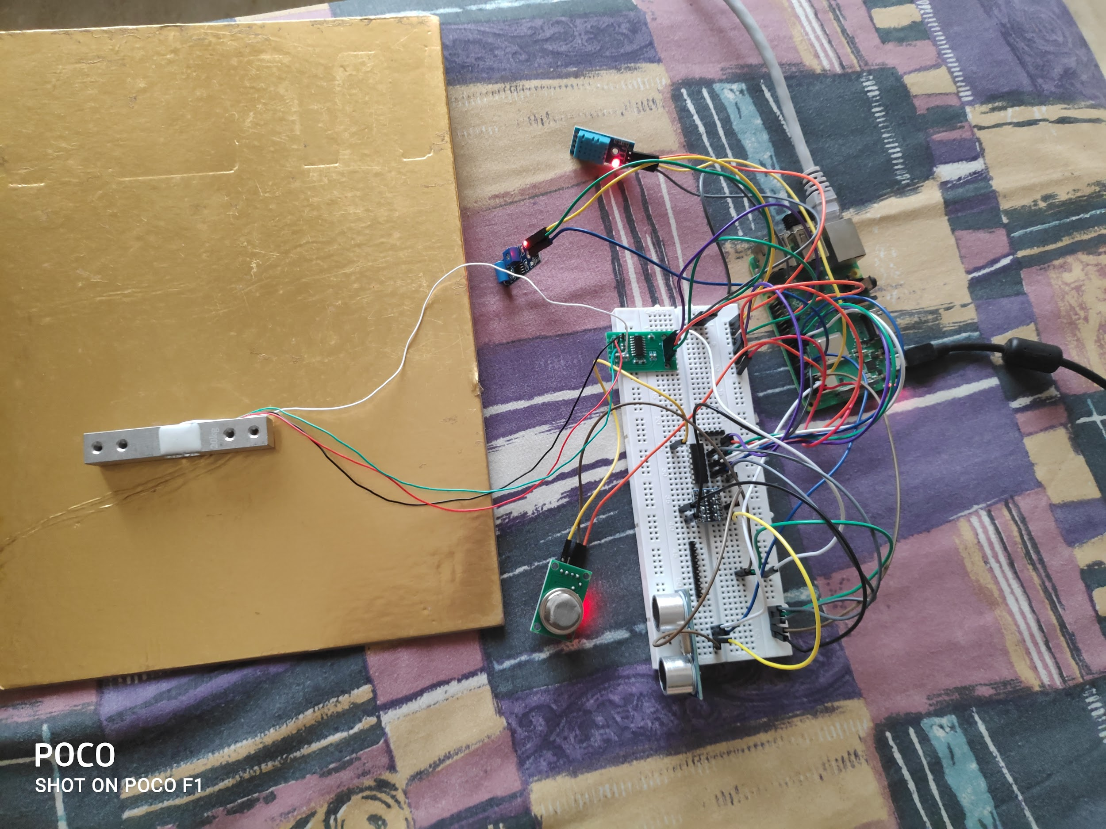
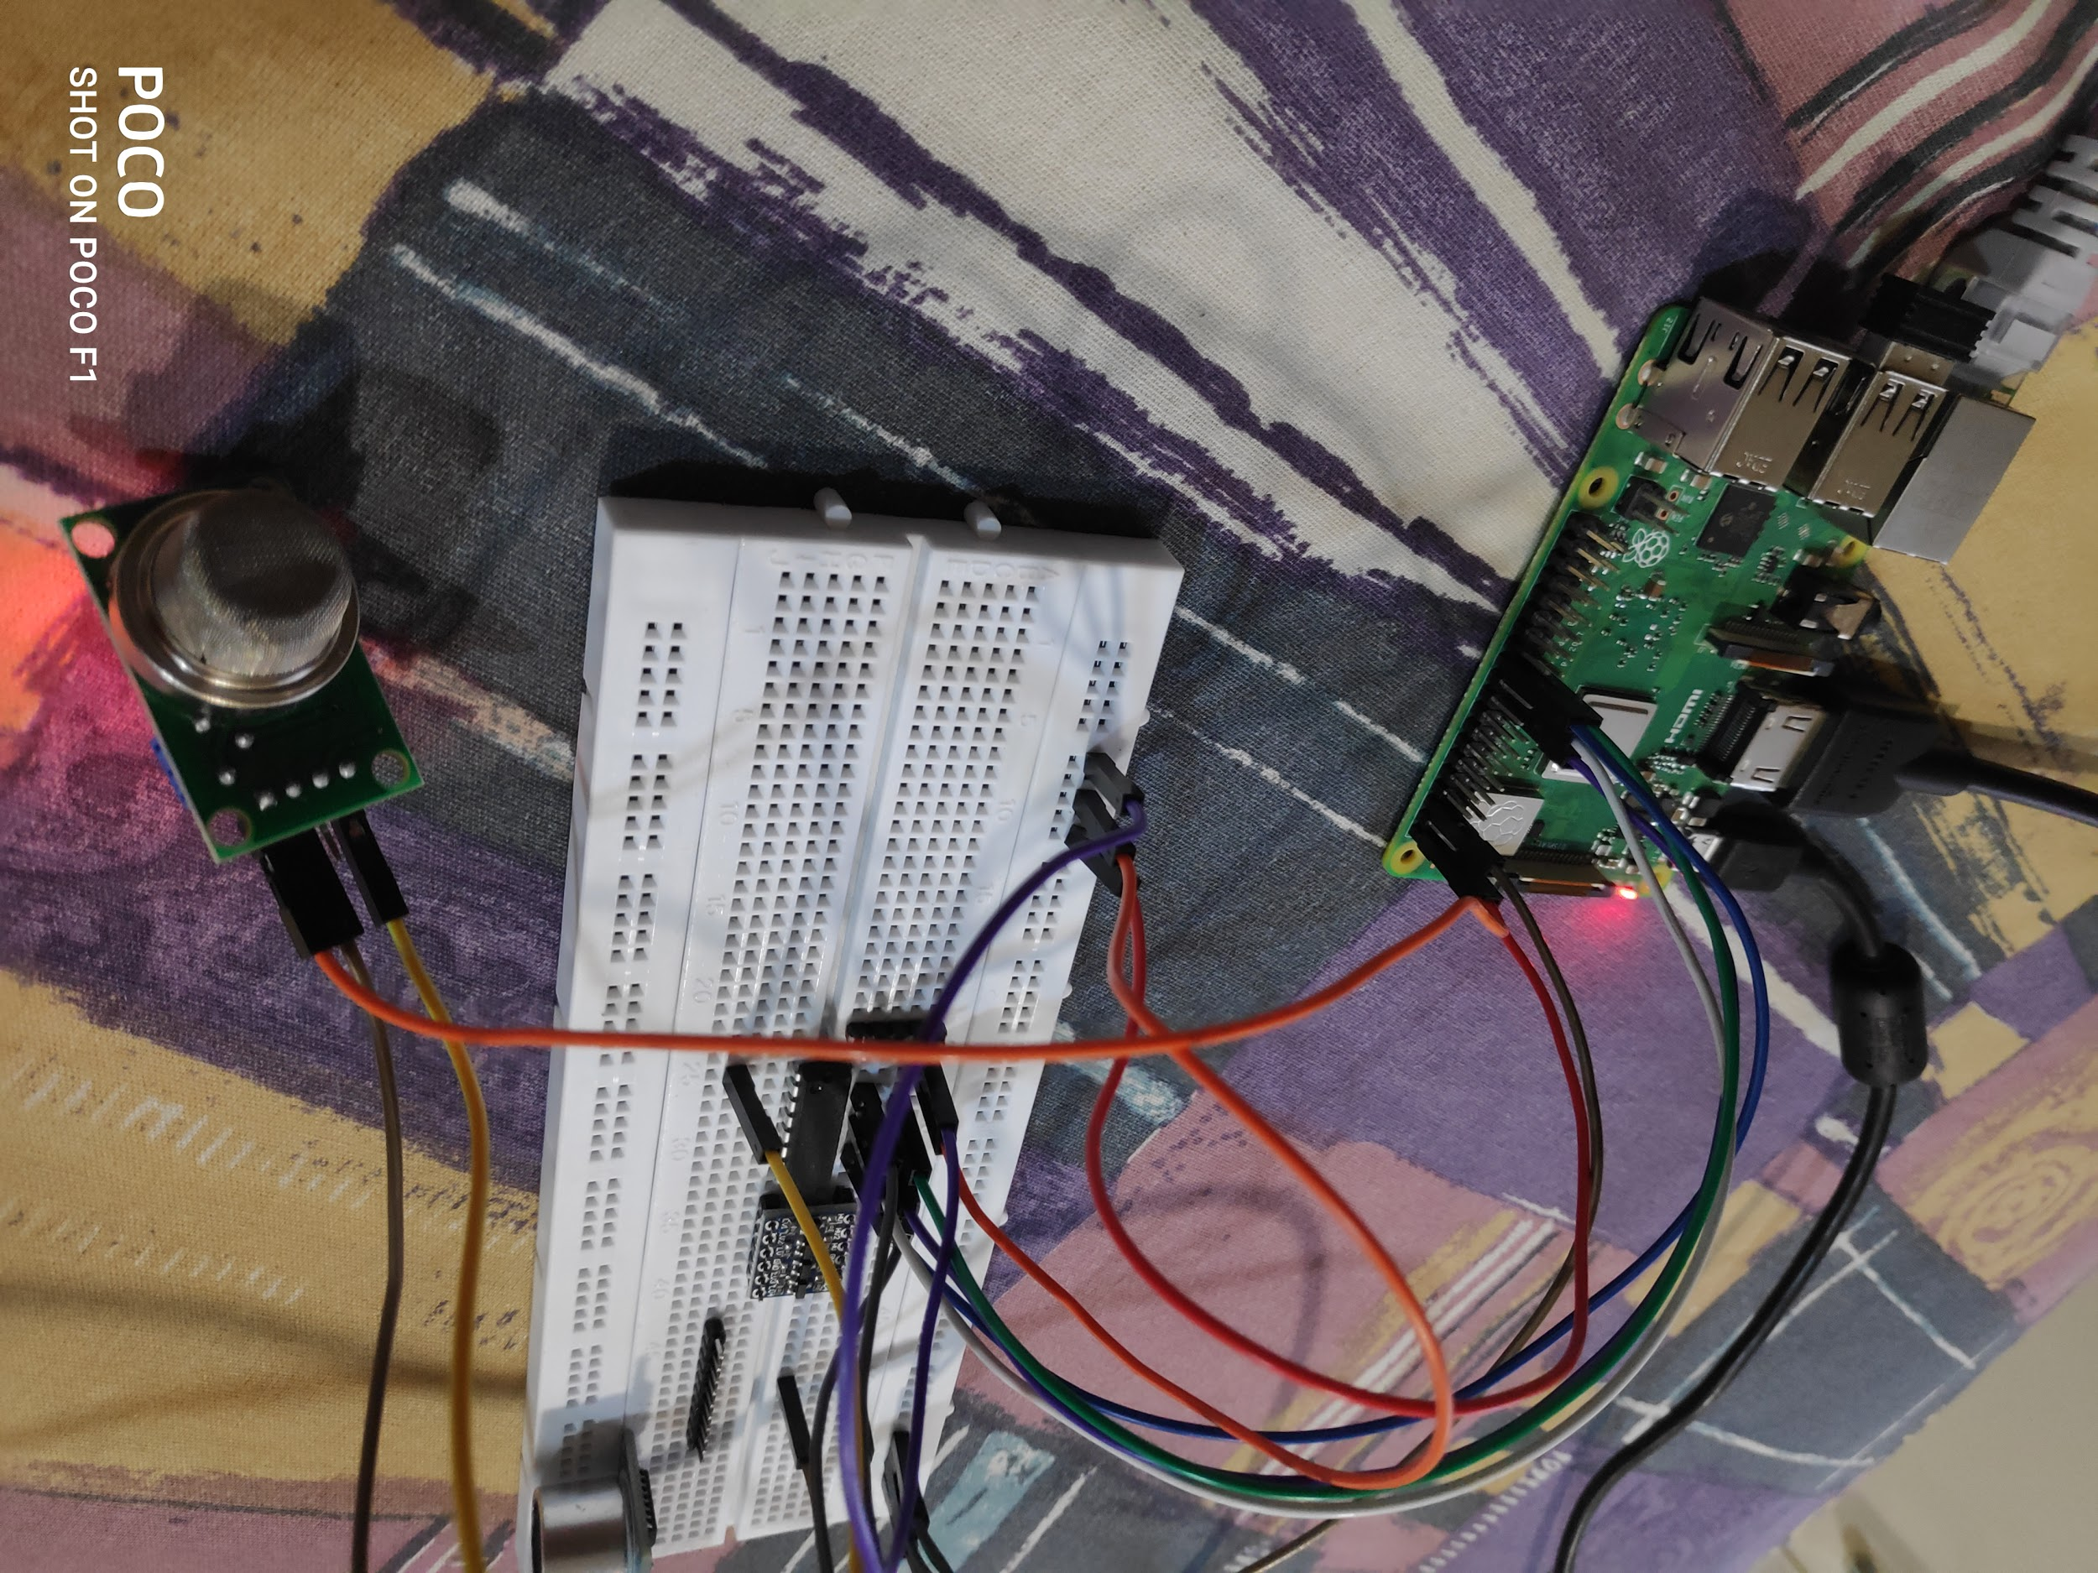
Prototype snapshots -

Slide 10
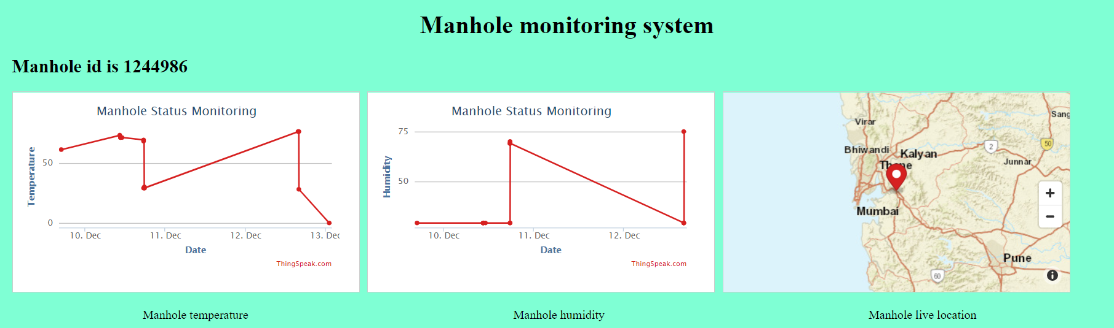
Web dashboard -

Slide 11
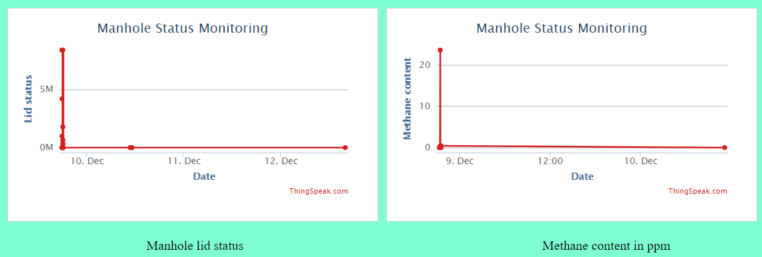
Web dashboard -

Slide 12
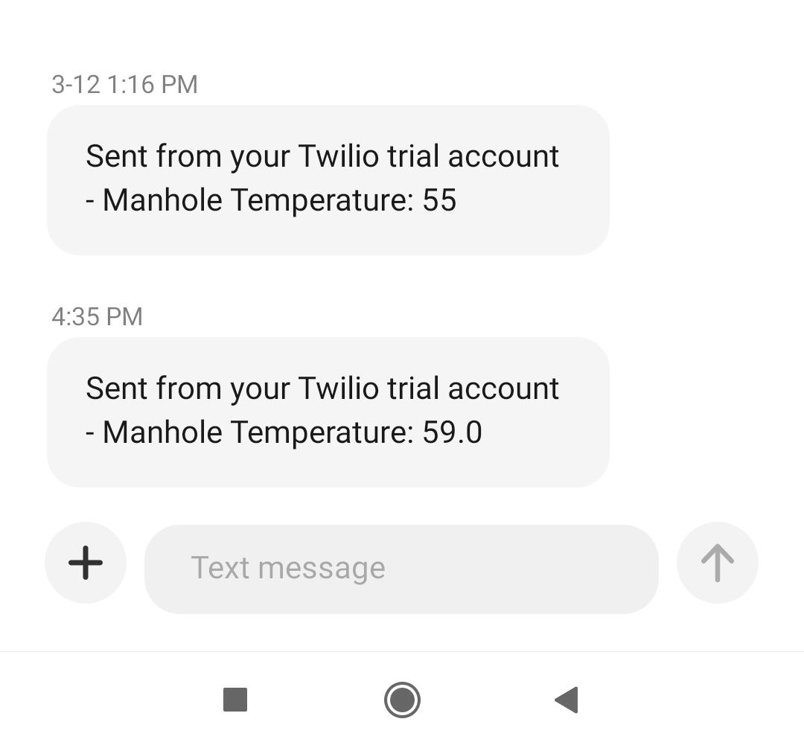
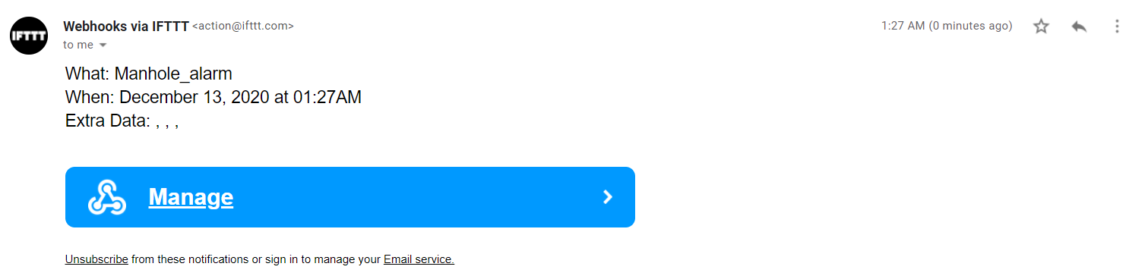
Alerts (email and SMS) -

Slide 13
Problems faced during the challenge -
Calibration of the gas sensor
Integration of all the sensors in a single code file
Set up and mounting for the load sensor

Slide 14
Conclusion -
In conclusion we would like to add that the project aims to create a system for smart monitoring of these sewage lines to reduce the deaths and help in better disaster control. We generally tend to ignore the important part our underground drainage systems and cleaners play in maintaining our cities!
Thankyou

